Slide 1

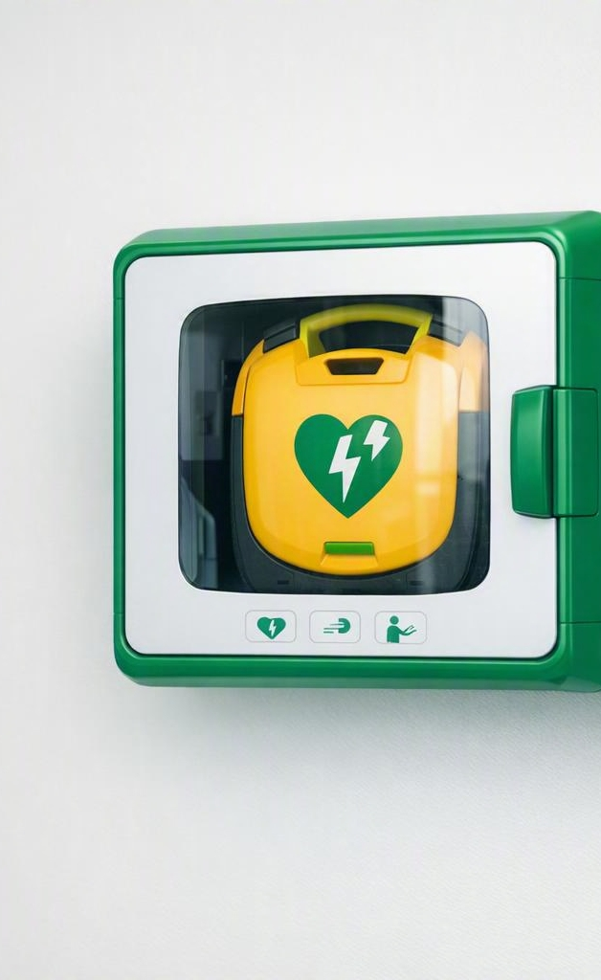
AEDs: The Device
That Restarts a Heart
EVERYDAY HEROES · PUBLIC SAFETY
A plain-language guide to Automated External Defibrillators — what they are, when to use one, and why every second counts.
Educational overview · Sources: American Heart Association, American Red Cross, FDA

Slide 2
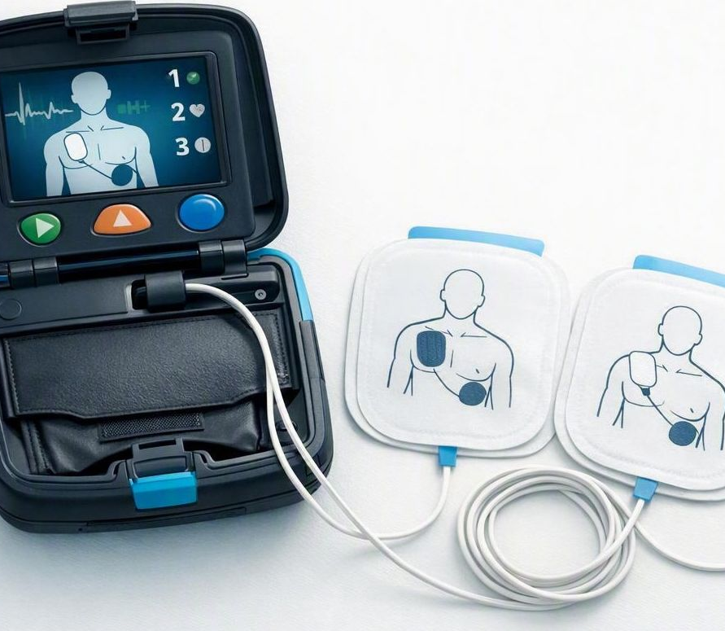
What exactly is an AED?
THE BASICS
An Automated External Defibrillator is a lightweight, portable device that reads the heart's rhythm and, if needed, delivers a controlled electric shock to reset it to normal.
It talks you through every step with voice prompts and lights — you don't diagnose anything; the device does.
Cardiac arrest
Heart attack
An electrical fault — the heart quivers and stops pumping. The AED treats this.
A plumbing problem — blood flow is blocked. Related, but not the same event.

Slide 3
Sudden cardiac arrest is common — and deadly
WHY IT MATTERS
~350K
~9 in 10
~1 in 10
2–3×
Out-of-hospital cardiac arrests each year in the U.S.
Are fatal — most happen at home, with no warning
Survive to hospital discharge under current care
Better survival odds with immediate CPR + an AED
The takeaway: bystanders — not just paramedics — decide whether someone survives the first critical minutes.

Slide 4
Every minute counts
THE CLOCK
Survival drops about 7–10% for every minute that passes without defibrillation.
A shock delivered within the first 3–5 minutes can push survival back up toward 50–70%. That's why an AED nearby changes everything.
Estimated survival by time-to-shock (illustrative, based on AHA / Red Cross guidance).

Slide 5
The Chain of Survival
THE BIGGER PICTURE
Each link buys time for the next. An AED is the link that actually restarts the heart.
1
2
3
4
5
6
Call 911
Start CPR
Use an AED
EMS Care
Hospital
Recovery
Recognize collapse & get help
Push hard and fast, chest center
Rapid defibrillation
Advanced responders arrive
Post-arrest treatment
Rehab & follow-up
High-quality CPR keeps blood flowing — but only a defibrillator can restore a normal heartbeat.

Slide 6
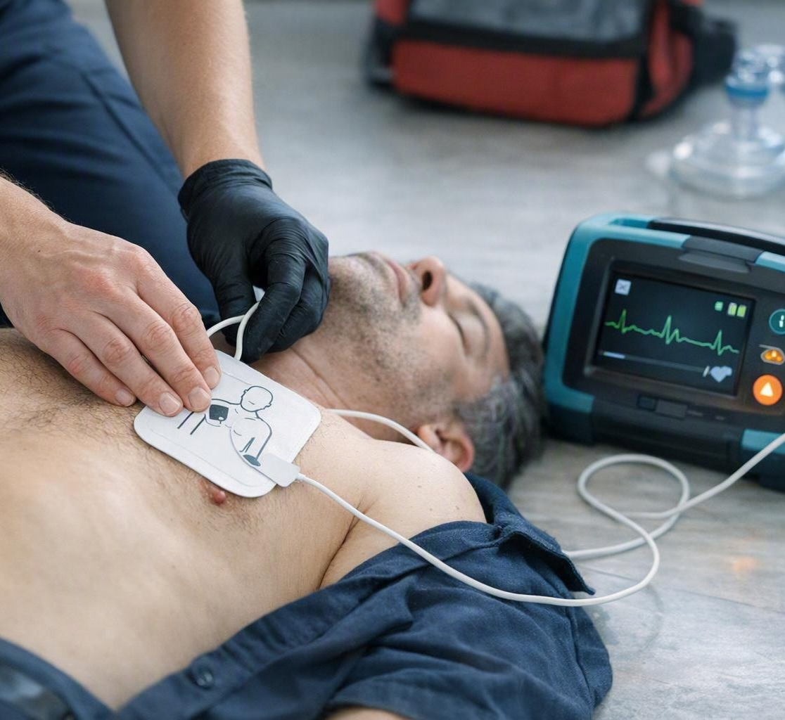
Using an AED: just follow the voice
STEP BY STEP
1
Check & call Confirm no response or breathing. Call 911.
2
Power on Turn on the AED the moment it arrives.
3
Attach pads Bare, dry chest. Place pads as the pictures show.
4
Stand clear Let it analyze — no one touching the person.
5
Shock if advised Press the button, then resume CPR right away.
No medical training required — the device analyzes the heart and decides when a shock is safe.

Slide 7
It's safer to act than to wait
MYTHS, BUSTED
“I could shock the wrong person.”
“You need to be trained.”
Fact: The AED only shocks a rhythm that needs it — it locks out otherwise.
Fact: AEDs are built for bystanders. Voice prompts guide you the whole way.
“What if I get sued?”
“It's not safe for kids.”
Fact: Good Samaritan laws protect people who help in good faith.
Fact: It is — use pediatric pads when available, adult pads if not.

Slide 8
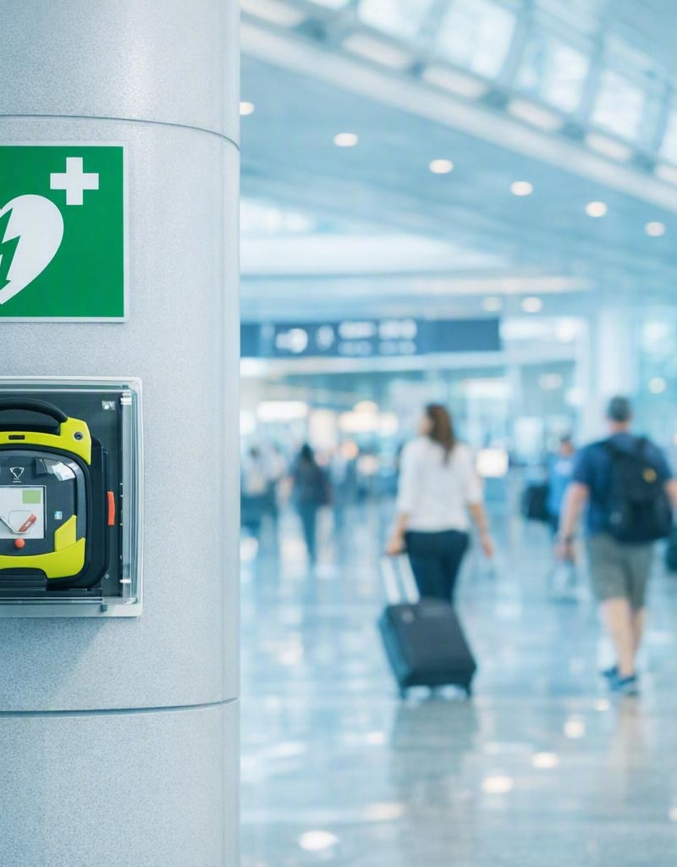
Know where yours is
PUBLIC ACCESS
AEDs are placed where crowds gather — ready for anyone to grab. Look for the green heart-and-lightning sign.
Airports, train & transit stations
Schools, gyms & sports venues
Malls, offices & government buildings
Available for homes — no prescription needed
Only ~50% of workers can locate the nearest AED — find yours before you need it.

Slide 9

You could be someone's best chance
REMEMBER THIS
Cardiac arrest is sudden — and survivable if you act fast.
CPR buys time; an AED restarts the heart.
The device tells you what to do — you can't hurt someone by trying.
Know where the nearest AED is, today.
In an emergency, call 911 immediately. Sources: American Heart Association, American Red Cross, U.S. FDA.

